Slide 1

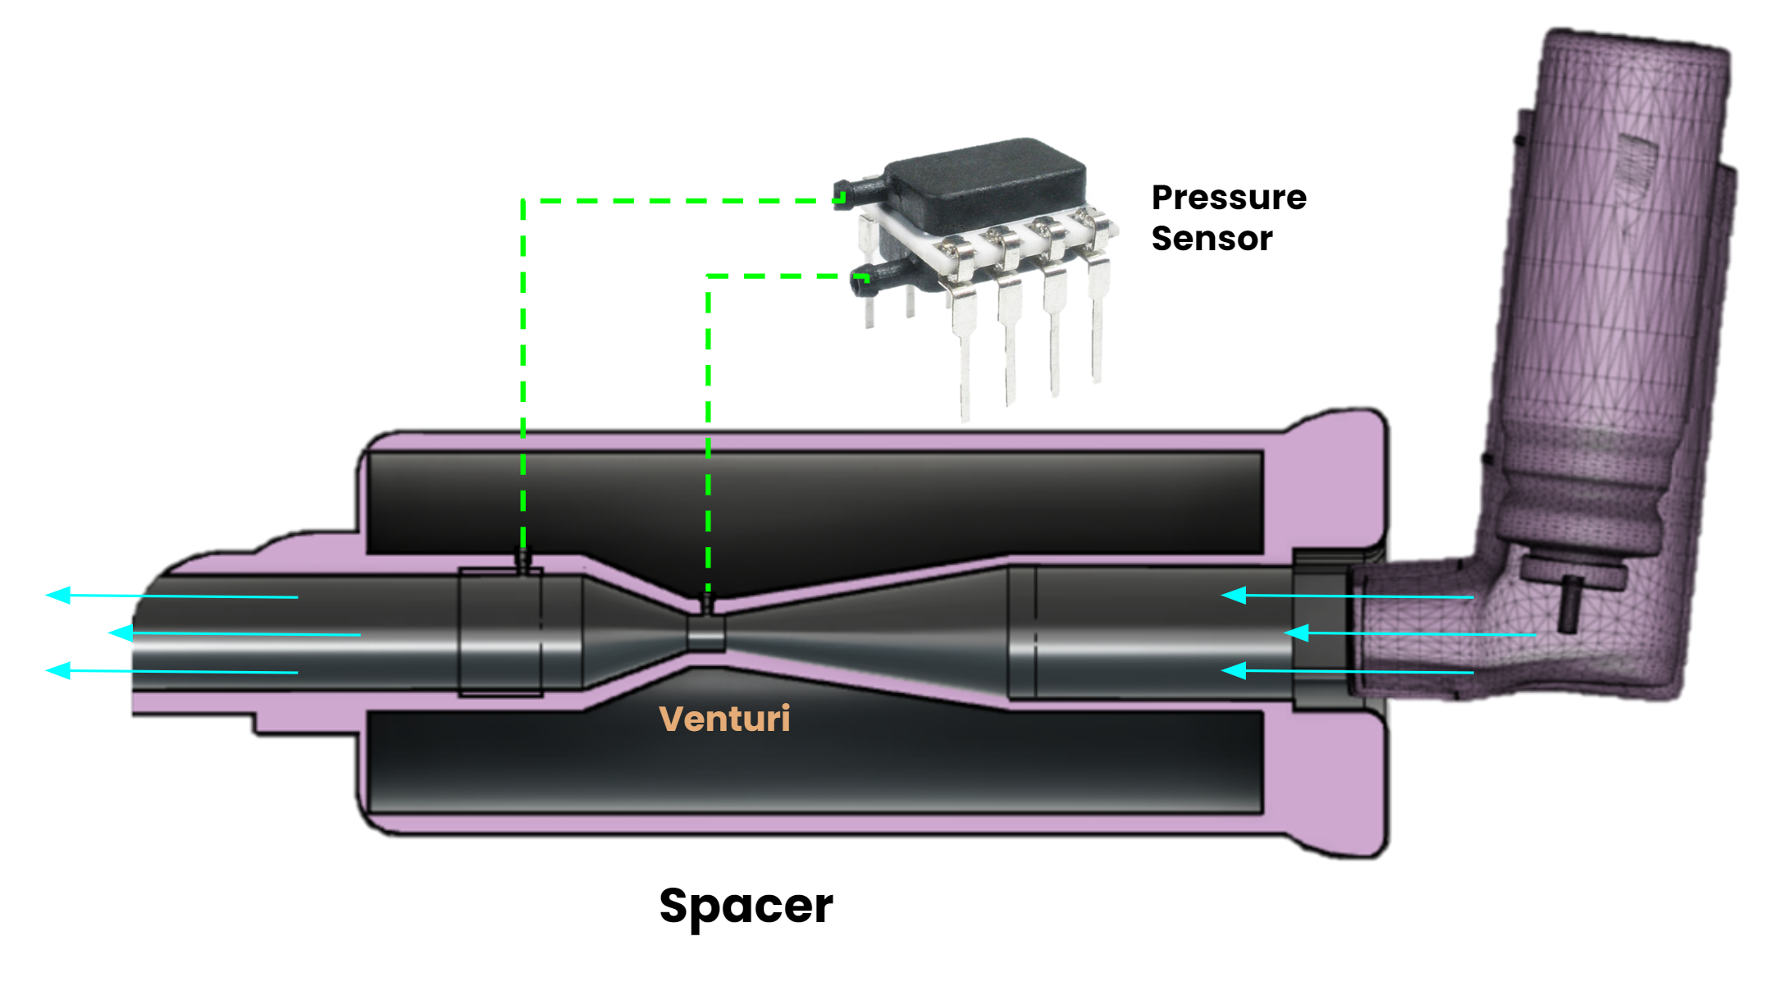
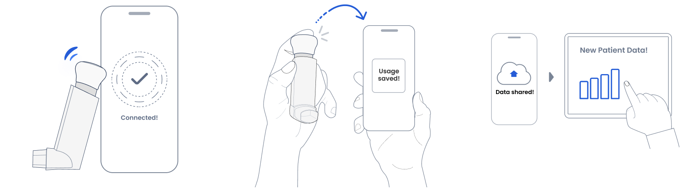

How Can a Smart Inhaler Device Help Patients
Isaac Garcia, Bishwanath Bistola, Eric Rizk,
University of New Mexico
ABSTRACT
APPLICATIONS AND BENEFITS
SIGNIFICANCE
THE PATH FORWARD
The World population is estimated to be 7.6 billion people, most of which are living in urban areas. In 2017 over 54% of the world's population were living in cities. This is a dramatic difference from 80 years earlier in 1927 where only about 15% populated cities (4). Now roughly 82% of the US population (327 million) live in urban areas. If the population increases to its estimated size of 9.1 billion in 2050 then that implies food production needs to increase by an additional 70%. Due to the rise in food demand and reliance on farmers is more prominent than ever, making a way to drastically increase the amount of food we harvest each year would bring exponential benefits. As plasma becomes more intertwined with the worlds agriculture we are seeing larger, more healthy, crop yield improving the way we provide humanity with the necessary nutrients needed for sustainability
.
This project is to develop a smart medical device, using a traditional inhaler and spacer setup, that can integrate with smart phones to collect data on when, where, and how well the patient uses the device. The project will re-imagine and re-design a crude prototype of the inhaler that we developed over the past year into a smart inhaler that we can put into the hands of regular people. The project will supply state-of-the-art embedded computer development boards, debugging systems, sensors, and 3D printing materials for students to use up and turn into products. In short, we would like to incorporate NOx sensors and digital pressure sensors to capture patient data that interfaces with BLE. The device should prevent exhalation into the smart inhaler, which may foul the flow sensor used to measure inspiratory flow rate. By integrating a function that allows for varied device operation through an inhalation (default) and exhalation (specific action) modes we can protect the flow sensing device while still being able to monitor NOx levels. Also reducing the possibility of damaging the flow sensing device components.
This will be the only device that can measure medication adherence. In other words we can send data to your doctor to see if your inhalation practices are improving or declining. We are focusing on tackling the most common practices that asthma patients face such as forgetfulness, poor understanding of their illness and inappropriate inhaler usage.
Our team proposes to develop a SI that is capable of measuring PIF during inhaler use. PIF will indicate whether the dose was delivered to the lungs to achieve optimal clinical benefit. The Asthma patient will be rewarded with audio and visual feedback from the device once the device registers that a dose of medication has been taken. This positive feedback will further reinforce the medication adherent behavior. In addition, for the coming Smart Inhaler team, we have made plans to add more features to the device like tracking the inhaler using GPS embedded into the device board, preventing dose dumping by adding fingerprint sensors for activating the device, and visual/audio feedback to allow for a pleasurable response.
Asthma affects a huge group of people; 25 million people have asthma in the US Adherence rates for asthmatic patients are particularly problematic, ranging from 30% to 70% . Fewer than half of the patients take inhaled asthma medications to adhere to their prescribed regimens.
An estimated 13% to 27% of ED visits in the United States could be managed in physician offices, clinics, and urgent care centers, saving $4.4 billion annually (Weinick, et al., 2010).
Balardini et al., examined emotional, cognitive, and behavioral problems and resources that influence management of asthma by using the Adherence Schedule in Asthma survey. The results show that 49.2% of patients do not accept their illness limitations and 25.4% of participants do not have adequate knowledge of the disease. The survey also found that 25.4 % of participants are unable to take their medicines correctly 25.4% and are unable monitor clinical parameters such as PEF or maintain a diary 57.1 %. (Source)
Asthma creates an economic problem, researchers have estimated direct and indirect costs at nearly $82 billion annually in the United States, alone .
The global asthma spacers market was valued at USS 1,330.56 Mn in 2017. In North America, the market is estimated to be US$545.60 Mn. It is expected to expand at a CAGR of 3.7% from 2018 to 2026. Rise in the geriatric population, high prevalence of asthma, and an increase in patient preference for the MDI/spacer combination are the major drivers of the global market.
Behavioral Study
Analyze Behavior of Athma Patcience
Device
Can communicate to a Smart Devise
Live Feedback of Your Current Condition
Consumer Product
Transmit data to your provider
SMART INHALER CONCEPT
SMART INHALER DESIGN
“We are rooted in behavioral science research and target unintentional and nonintentional nonadherence to create a habitual medication adherence behavior”
- Amelia Bierle (Manager)
STANDARDS
Electrical requirements:
IEC 60601-1:2005 + A1:2012
IEC 60601-1-2:2014
IEC 60601-1-11:2015
IEC 60601-1-8:2006+AMD1:2012
IEC 60601-1-6:2010+AMD1:2013.
FCC Allowance Spectrum (Bluetooth data transfer and interfaces):
EMC Regulations for 2.4 GHz-Emission Limits for the 2400-2483.5 MHz Band
Connect Your Smart Device
Collect Your Data
Share Your Data
There are three main reasons for patient non-adherence to asthma treatment:
Forgetfulness
Treatment-related concerns including complicated treatment, poor understanding of the illness and inappropriate inhaler usage
Psychological barriers including poor patient motivation, lack of trust in the efficacy of the treatment and low perceived control over the treatment.
Bluetooth Compatible
SPI – protocol
Bluetooth Low energy
(consumes minimal amounts of power)
Differential Pressure Sensor
Dual port sensor allows for and
Venturi
Allows us to be able to convert pressure
To flow rate
SUPPORTING DATA FOR VENTURI DESIGN
https://en.wikipedia.org/wiki/Heat_capacity_ratio gives the isentropic exponent for air at 20C as 1.400. This number is fairly solid as it ranges from 1.403 at 0C to 1.401 at 100C. https://www.engineeringtoolbox.com/specific-heat-ratio-d_602.html gives the same answer.
Understanding Bernoulli's Equation - incompressible flow: https://www.youtube.com/watch?v=DW4rItB20h4

